Slide 1

IST 261 (Fall 2019)
Application Development Design Studio I
Try-Catch Blocks
Phil O'Connell
pxo4@psu.edu

Slide 2
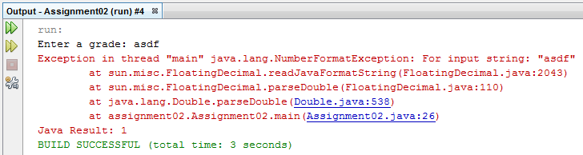
Runtime Error
grade = Double.parseDouble(userInput);
If the user typed in "asdf", this line will have an error at runtime, because it's not a number
Cannot be parsed into a double
Runtime errors are Exceptions

Slide 3
How Do We Handle Errors?
Java provides try-catch blocks
You try some code, and if there is an error, you catch the exception to handle the problem
try {
some code that may throw an exception;
} catch (ExceptionType name) {
take action on the error
}

Slide 4
Example
You can use try/catch to handle invalid input
double grade = 0;
userInput = keyboard.readLine();
try {
grade = Double.parseDouble(userInput);
} catch (Exception e) {
System.out.println(e.getMessage());
}
getMessage() returns the error message of the exception
e or ex are typically the names everyone uses to refer to the exception

Slide 5
The Exception Class
On the previous slide, we "caught" an object of type Exception
That means "any exception"
It's called the "general exception"
But, there are different classes of exceptions. e.g.:
java.lang.NullPointerException
java.lang.NumberFormatException
We won't cover too much of that aspect
We will deal mostly with the general exception

Slide 6
Finally
finally is an optional part of a try-catch block
The finally block will ALWAYS run
Except in extreme situations
e.g., the JVM is killed
Useful for cleanup
e.g., release the lock on a file you're reading

Slide 7
Syntax Using Finally
The syntax for a try-catch-finally block is
try {
some code in here;
} catch (ExceptionType name) {
take action on the error
} finally {
this will execute even if there was no exception
}

Slide 8
When to Use try/catch?
If the IDE won't compile without it
Some methods in Java require you to try/catch
When you know how to deal with the problem
Otherwise let the exception "bubble up"
Let the whoever called your code deal with it
Put as little as possible in the try block
try blocks require a little bit more overhead
Don't put in code that won't give an exception
Unless you have a very good reason
Example of a reason is on the next slide...

Slide 9
Example of non-throwable Code in a try/catch block
The only code in the try block that will throw an exception is Integer.parseInt
boolean validInt = true;
try {
userIntAnswer = Integer.parseInt(userInput);
// Input must be positive
if (userIntAnswer <= 0) {
validInt = false;
}
} catch(Exception e) {
validInt = false;
}
We will only reach this block of code if the user input can be parsed into an integer.
So, this is a good place to check for it being negative.

Slide 10
Example of non-throwable Code in a try/catch block
The only code in the try block that will throw an exception is Integer.parseInt
boolean validInt = true;
try {
userIntAnswer = Integer.parseInt(userInput);
// Input must be positive
if (userIntAnswer <= 0) {
validInt = false;
}
} catch(Exception e) {
validInt = false;
}
If the user types in 12 then Java will continue along the try block

Slide 11
Example of non-throwable Code in a try/catch block
The only code in the try block that will throw an exception is Integer.parseInt
boolean validInt = true;
try {
userIntAnswer = Integer.parseInt(userInput);
// Input must be positive
if (userIntAnswer <= 0) {
validInt = false;
}
} catch(Exception e) {
validInt = false;
}
If the user types in asdf then Java will leave the try block, and go to the catch

Slide 12
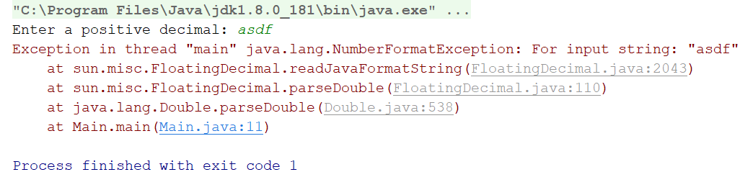
Catching Exceptions "In the Act"
When an uncaught exception is thrown, the program will end
Typically, you'll get a message on the console
But what if you want to debug that point when it's thrown?

Slide 13
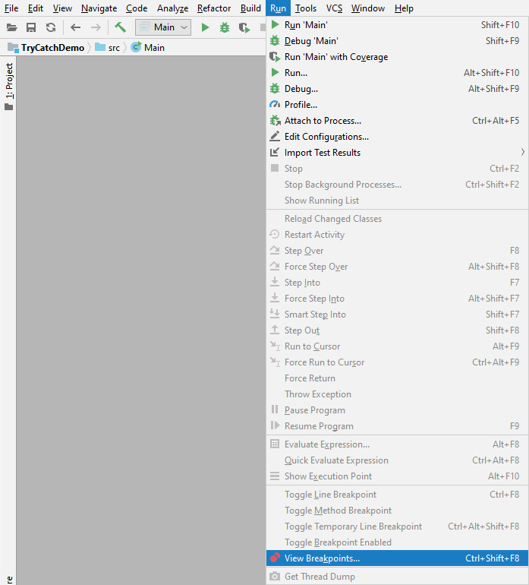
IDEA: View Breakpoints (Ctrl-Shift-B)
...

Slide 14
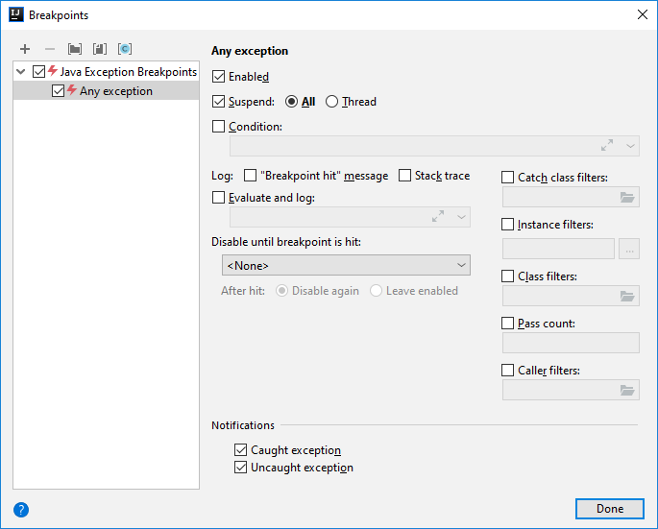
IDEA: View Breakpoints (Ctrl-Shift-F8)
Choose "Any exception"
Check "Catch class filters"

Slide 15
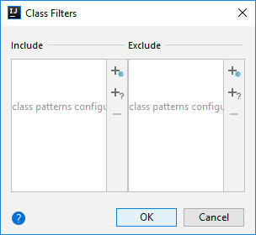
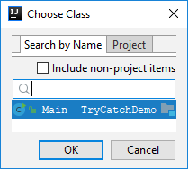
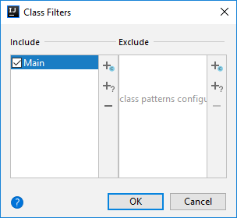
Filter By Class
We only want to break on exceptions in Main
If you have other classes, you can add them too

Slide 16
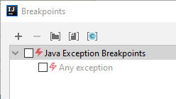
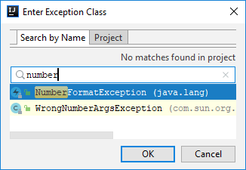

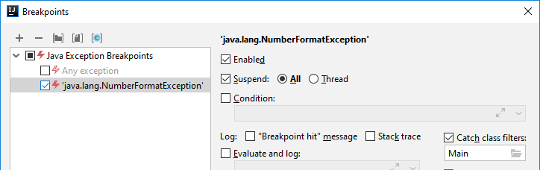
Filter By Class AND Exception
If you know the actual type of exception, you can filter by it
Remember your class filtering

